Slide 1
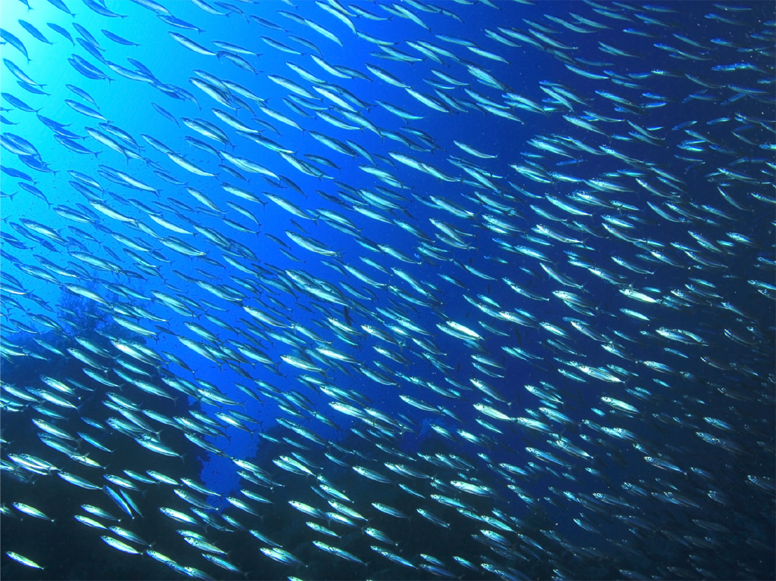
Ocean Networks Canada’s Underwater Video Acquisition, Logging and Curation
Reyna Jenkyns (reyna@uvic.ca)
Underwater Video Workshop, Rhode Island, 2016-06-01

Slide 3
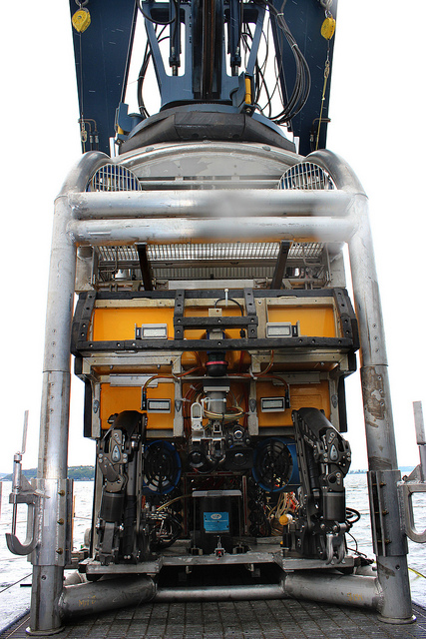
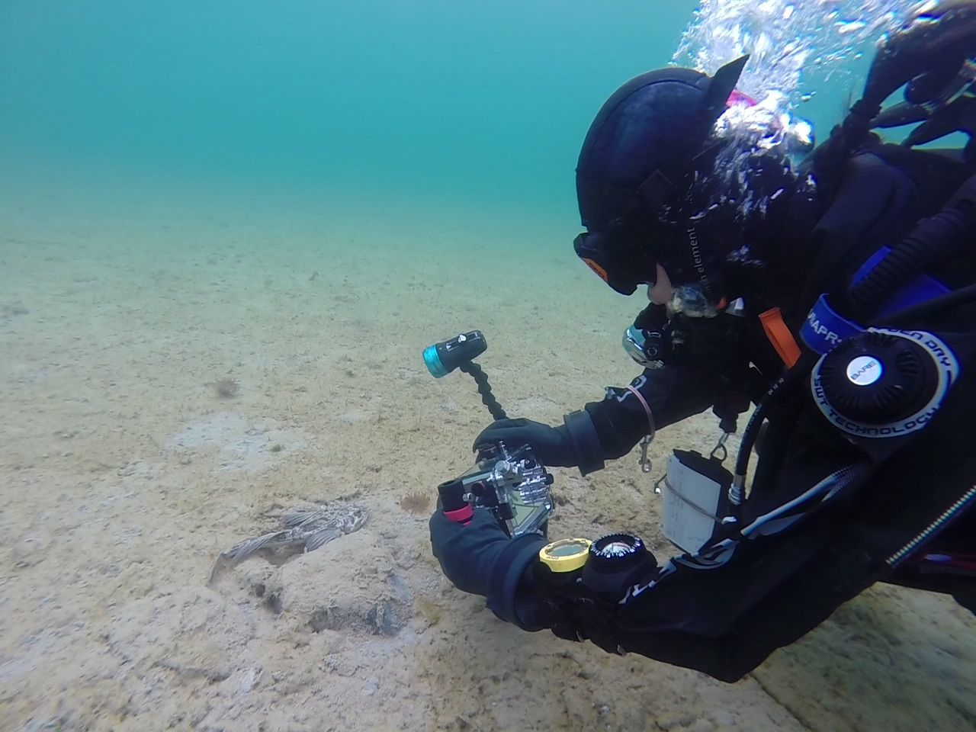
Camera and Platform Diversity
Platforms
ROVs: ROPOS, Jason II, Hercules/Argus, Oceanic Explorer, Zeus II, Millenium Plus, ST-204, Sea-eye Falcon
Divers: GoPros (usually)
Networked Platforms on seafloor
Camera Systems
Types: Colour, Black & White, 3D, laser scanning or sonar imagery integration
Equipment: lasers, lights, pan/tilts
Functions and capabilities: Zoom, focus, resolution, remote commands vs GUIs

Slide 4
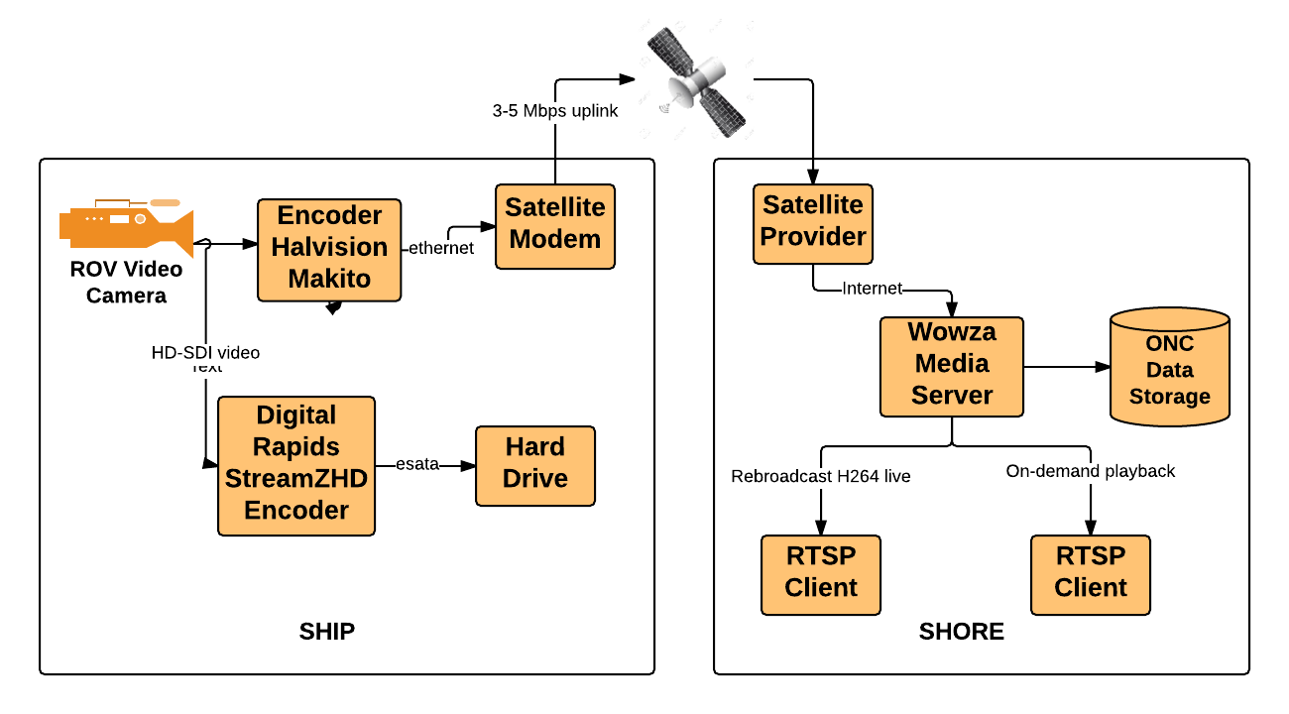
ROV Video Acquisition

Slide 5
Oceans 2.0: SeaScribe Dive Logging
Expedition
Dives
Observations
Comment
Description
Cruise Name
Ship Name
Duration
Description
Location
Duration
Dive Chief
Dive Reference ID
Timestamp
Logger
Tag
Resource
Platform
Identifier???
Increases searchability and usability of dive video
Supports derivative applications, such as comparison or training automated classifiers and generation of geodatabase layers
Future interoperability opportunities to query each other’s video based on annotations and ancillary data ranges?

Slide 6
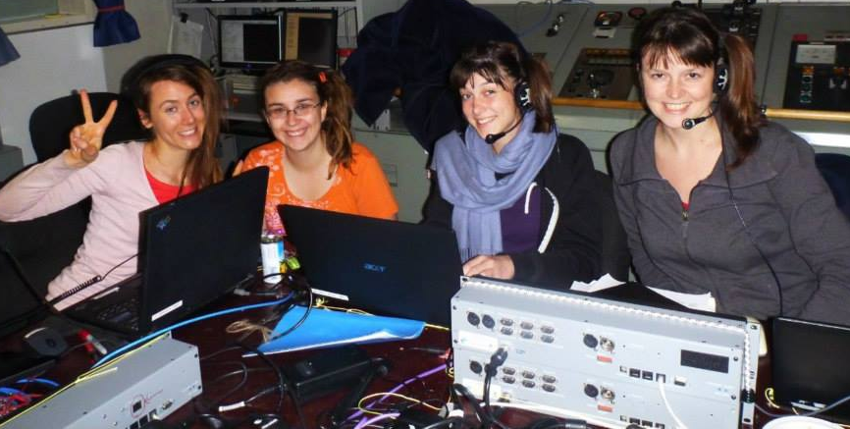
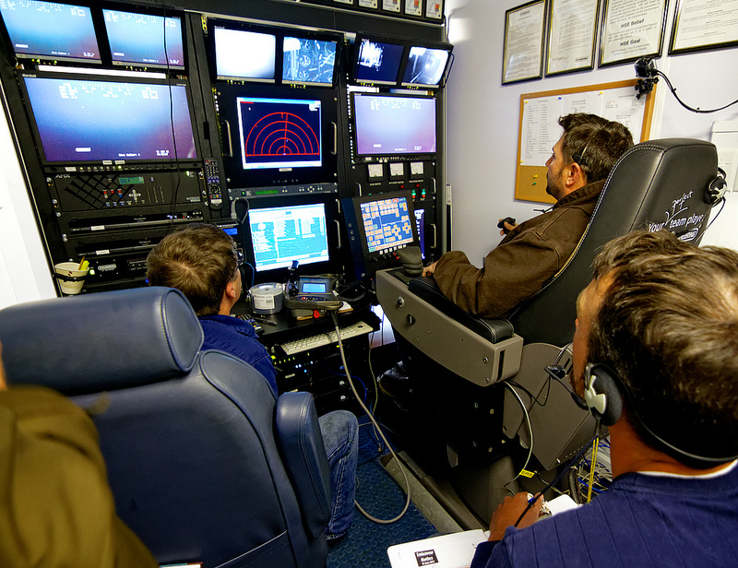
Oceans 2.0: SeaScribe Dive Logging
Operations
Samples
Seafloor
Organisms
Recently introduced standard syntax for surveys (visual, acoustic) and experiments.

Slide 7
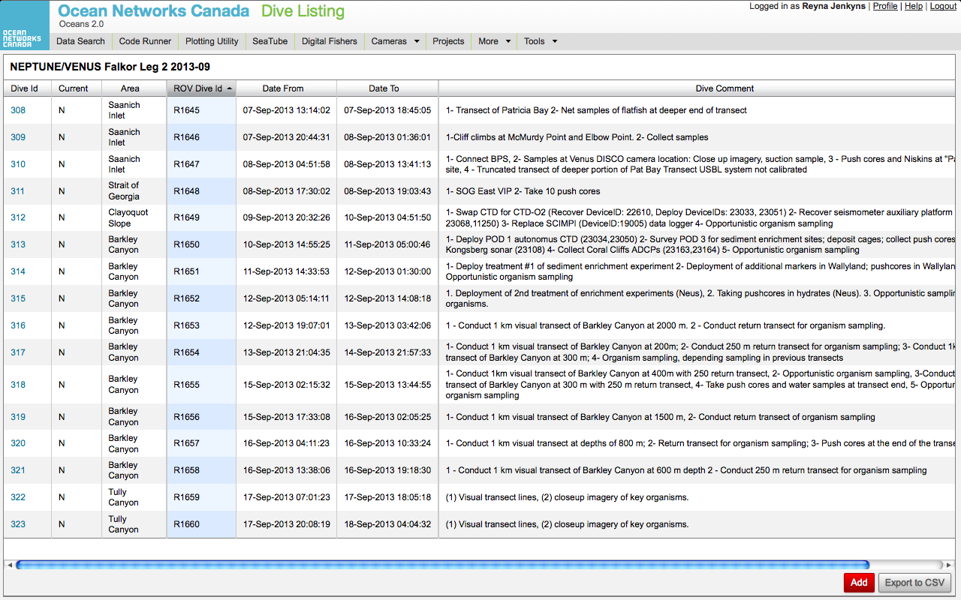
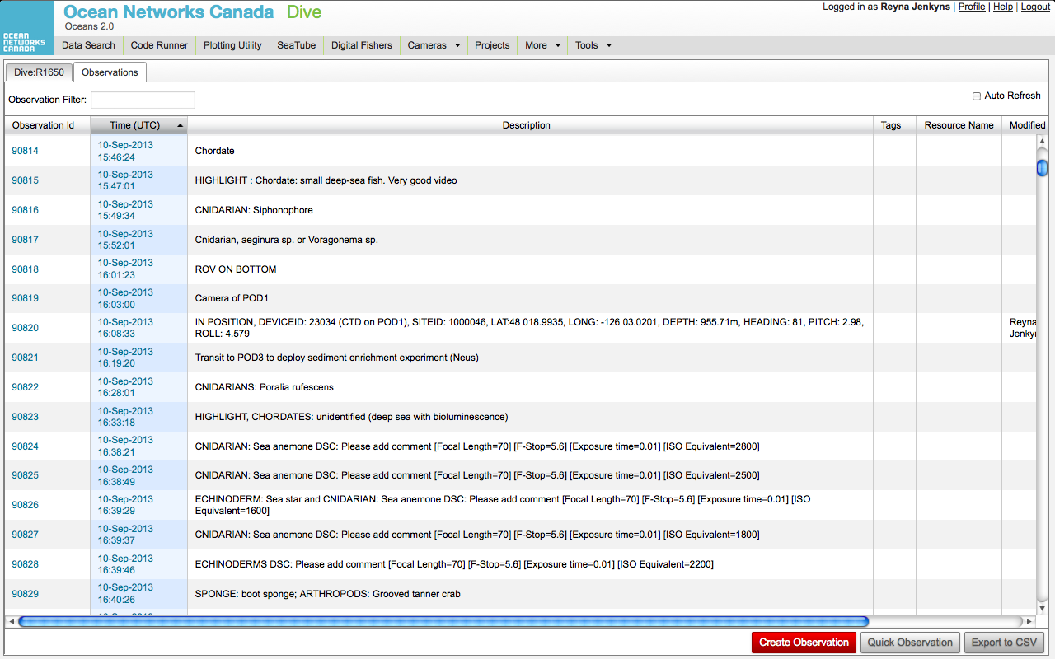
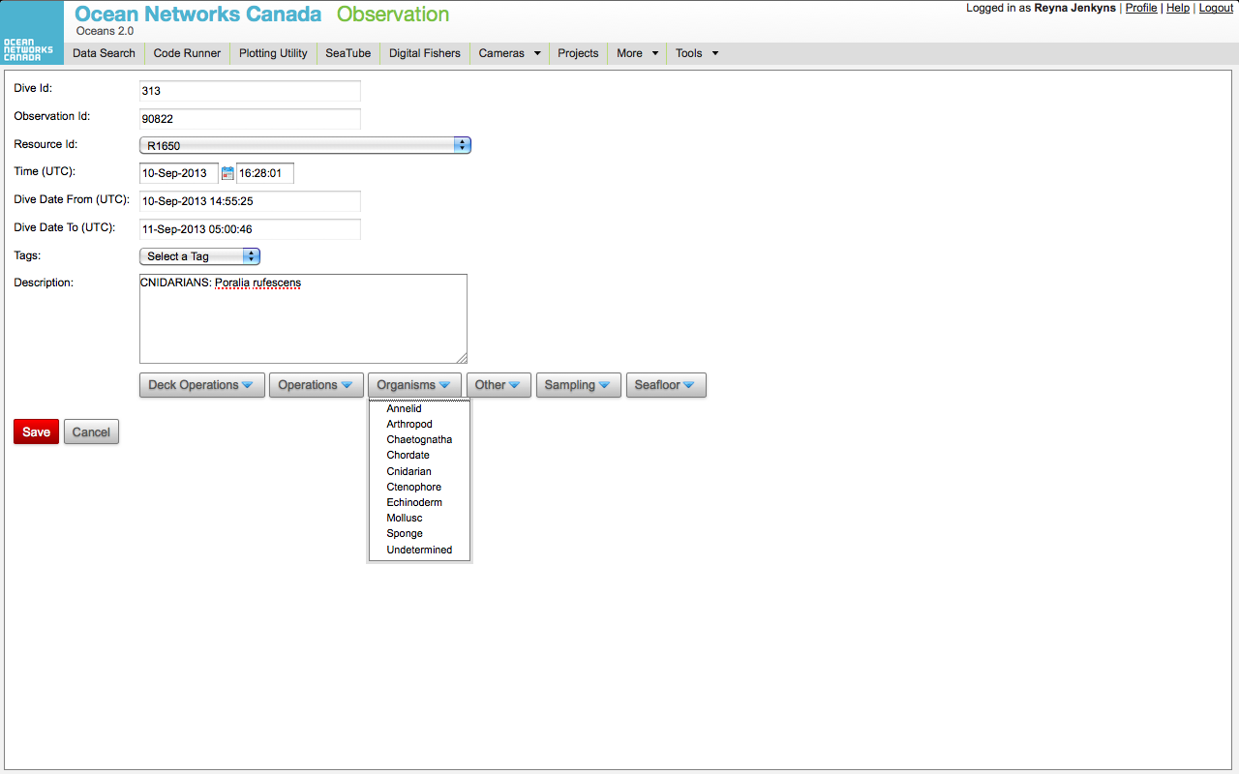
Oceans 2.0: SeaScribe Dive Logging

Slide 8
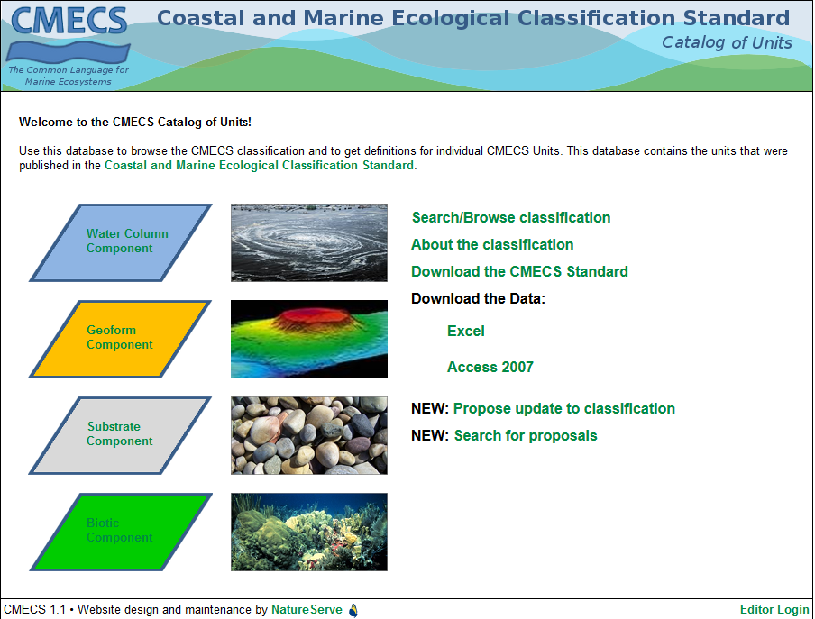
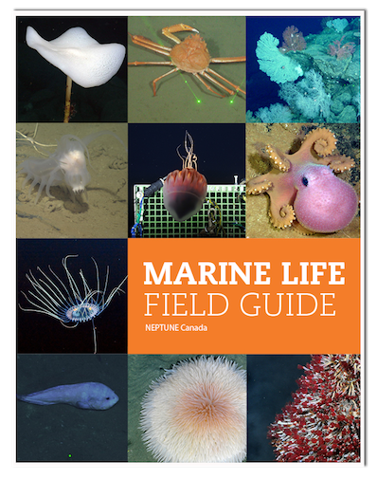
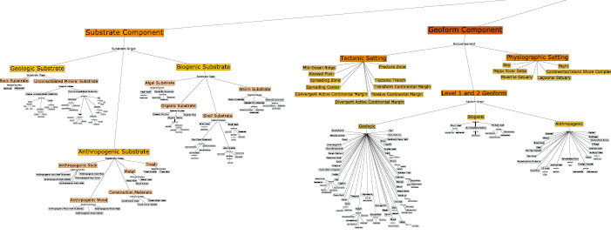
Oceans 2.0: Dive Logging Guides

Slide 9
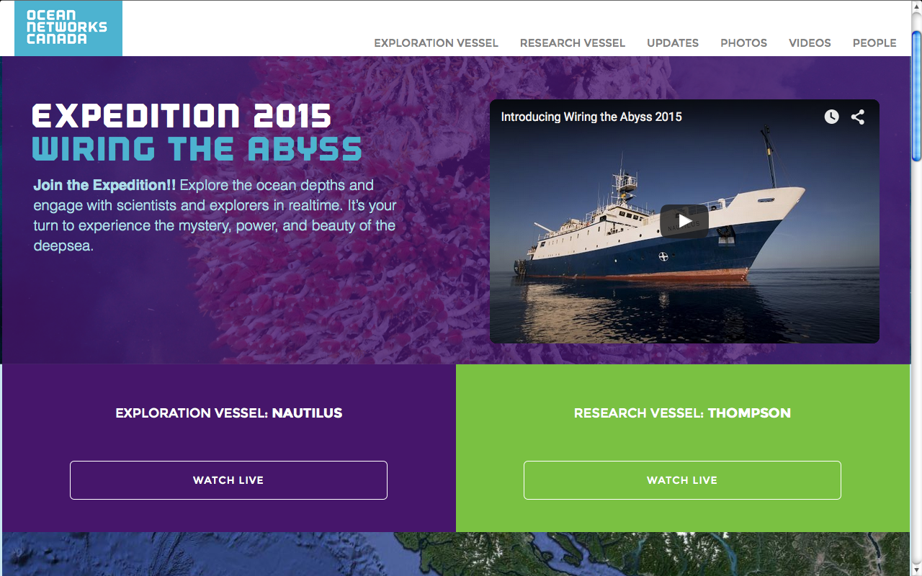
Wiring The Abyss Website

Slide 10
Curation Challenges
Consistent workflow due to variation of cameras, platforms and evolving nature of video (encodings, 4K?)
Filenaming with accurate timestamps
Embedding metadata
Closed captioning
Dive identifiers
Meeting demands of applications/stakeholders: science, MPA, outreach, media, image analysis
Transferring high-resolution video to scientists
Obtaining metadata about ROV camera system and recording settings

Slide 11
Digital Stills
Integration of digital still camera varies significantly from one ROV to another
Image capture ideally conducted by dive loggers, but sometimes it must be done by ROV operators or dive chief
Timestamping not always synced to time server
Download occurs after dive, although sometimes a preview is available
Final archiving occurs post-cruise
Integrated into SeaTube post-cruise
Potential opportunity for collaboration with ROVs and camera manufacturers for better integration and functionality

Slide 12
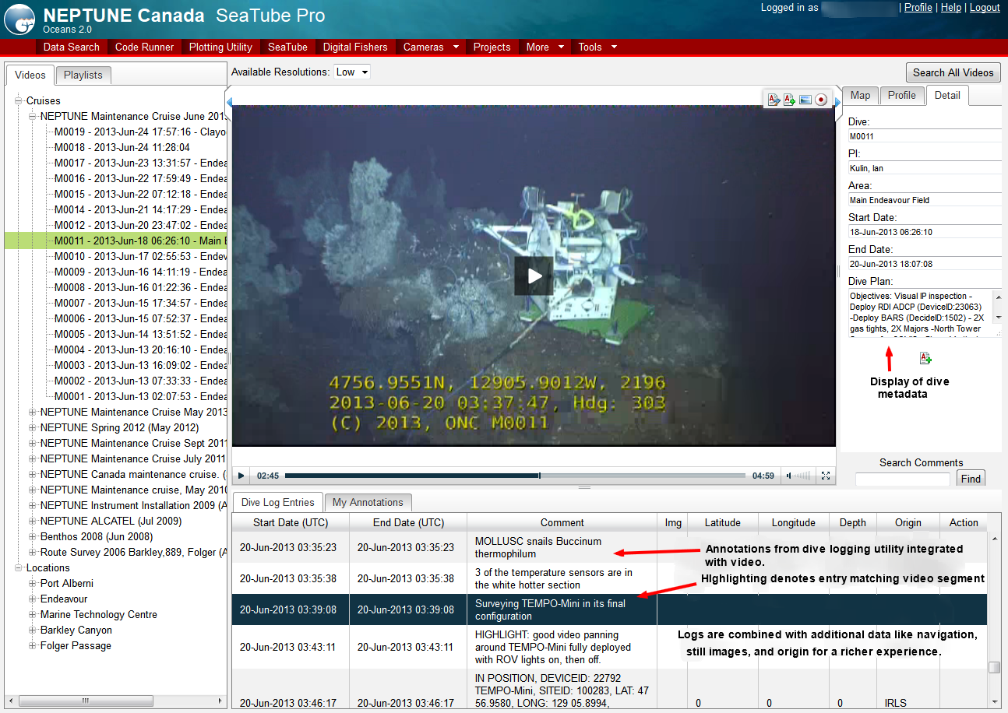
Oceans 2.0: SeaTube
Notes:
DOSI working group

Slide 13
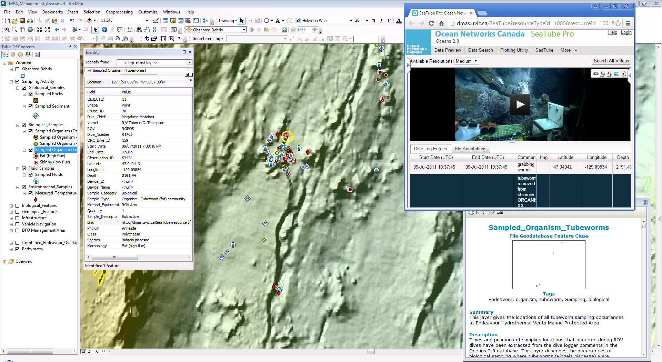
Endeavour Hydrothermal Vents Marine Protected Area:
Integrating Expeditions and Scientific Knowledge into a Geodatabase
Ihilitaquam ditat. Ficiam, serum fugitio cus, aut faccum re corere exerum, ute voloriberias aut quo quibus escia volent quodi occupta debitiisquas maio tecus
ruptatur reperum et omnihicit, sandam simi, siminctin perspidebit esto voluptatio volupta tquiae lanti ape volor res sum ad qui netur apitat.
Gendioratio eatum qui suntempe lam, sus abo. Sincta qui reiumque enet esci consequi odit autatur aliquidio beaquate adio offictae volorem earitis repudip istrum dolent lis dolo molorpor as moditia cone everis eicae plamet facea conse
ellabore dis ea aut volora senientem lam sequatus est vendus eturerferum restotatem que el ipis rerum nam, aut pro consedigenia se id ma sim et fugitia nderspero te derrovit faccus eliquassim quam.

Slide 14
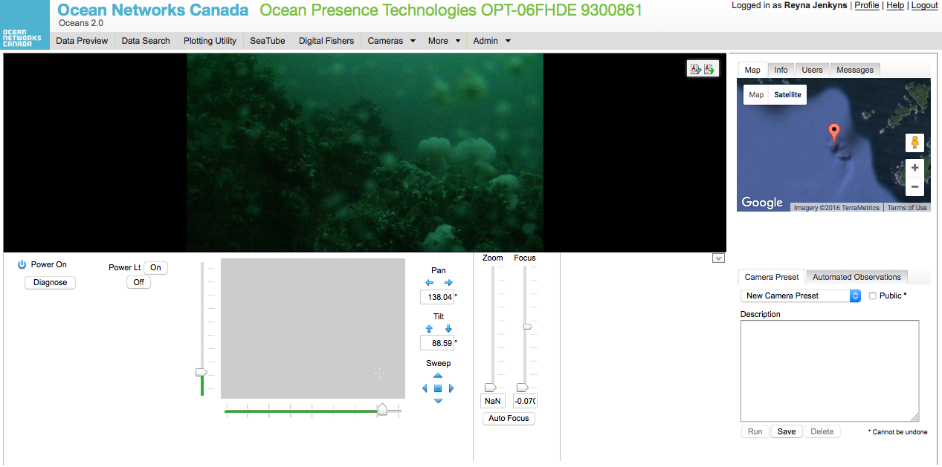
Fixed Cameras
Camera Control Interface;
SeaScript and Scheduling;
Wowza Recording – triggered off lights and other sensor data;
Automated QAQC – black video segments, expected field of views
13204::moveTo(1776.6, 2135.7); 13204::zoomTo(0.0); pause (5); 13204::changeLightIntensity("Lights", 100.0); pause(150); 13204::moveTo(6258.7265625, 1976.98876953125); pause(150); 13204::changeLightIntensity("Lights", 0.0);

Slide 15
Looking Forward
Workflow and Tool Improvements
Better integration of digital stills into SeaTube
Enhanced search functionality based on navigational or other data values
Data Stewardship
Legacy data ingestion: VENUS expeditions, pre-NEPTUNE expeditions, navigational data
Dataset citations
Improved dive logging conventions (especially for sampling and integration of identifiers such as IGSN)
Events
IEEE Video QAQC abstract submitted
Data Week SciDataCon Session #61: Towards Multimedia Data Curation Standards and Leading Practices for Enabling Scientific Research, CoChairs: A. Miller (SOI), R. Jenkyns (ONC)
2016 Computer Vision for Automated Analysis of Underwater Imagery Workshop

Slide 16
